Slide 1

MIT-5201
By-
Jesmin Akhter
Associate Professor
Institute of Information Technology
Jahangirnagar University

Slide 2

Lecture 03 &04

Slide 3
Example-1
A city has total population of 5,00,000. A network planar found the behavior of users of the city like: they generate 2 calls/hour with average holding time of 1.5 minutes. The service provider got the license of BW that can support 27 carriers of GSM. Determine number of sectors of 3/9 cell pattern maintaining GoS of 5%.
Ans.
Traffic intensity/user = 2(1/60)1.5 = 0.05Erl
Carrier/sector = 27/9 = 3 carriers
Traffic channels/sector = 3*8-3 = 21
Where one TS out of 8TS is considered as control chanel.
From Erlang’s table,
For n = 21 and B = 5%, offered traffic A=16.189Erl
Number of users/sector = 16.189/0.05 = 324
Number of sectors = 5,00,000/324 =1544
Number of 3-sectored cell = 1544/3 = 515
Number of cell pattern = 515/3 = 172 or 1544/9=172
Sector-1
Sector-2
Sector-3
Sector-2
Sector-1
Sector-2
Sector-1
Sector-3
Sector-3
Number of users/cell= 324*3=972
Number of cells(3-sectored)
= 5,00,000/972 =515
Notes:
GOS of 2% blocking.
This implies that the channel allocations for cell sites are designed so that 2 out of 100 calls will be blocked due to channel occupancy during the busiest hour.

Slide 4
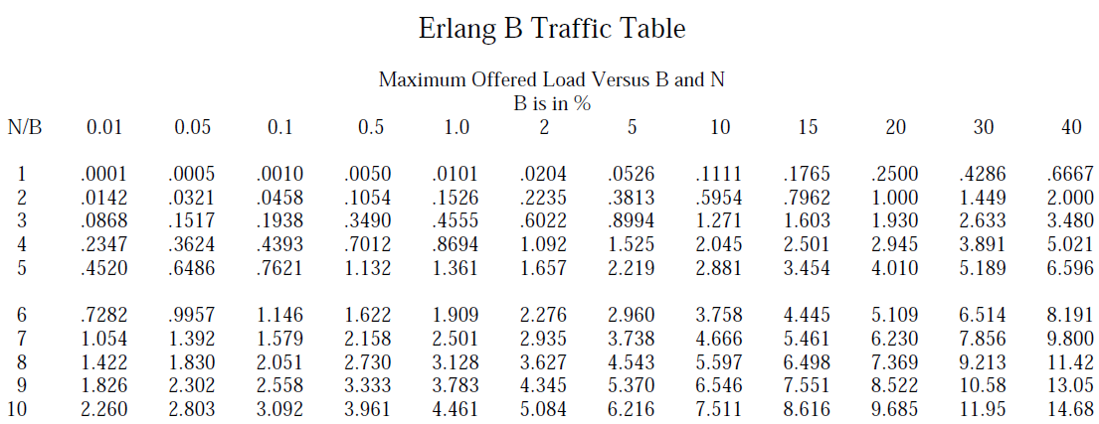
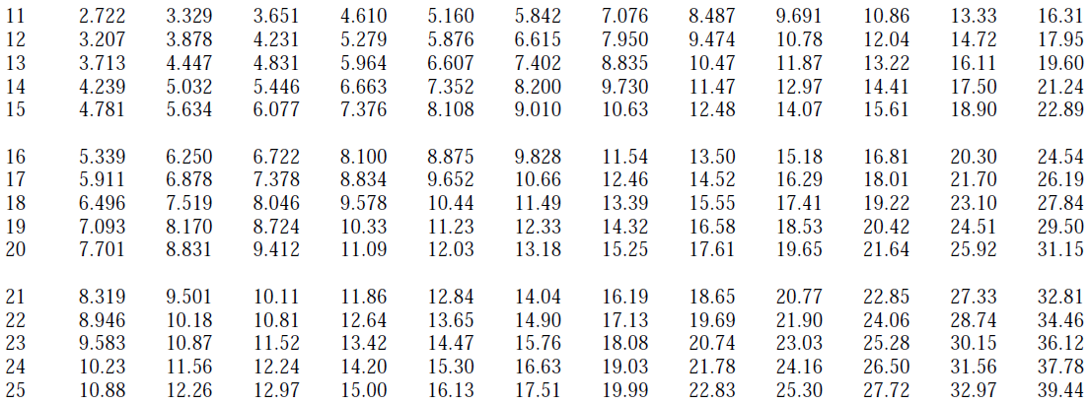

Slide 5
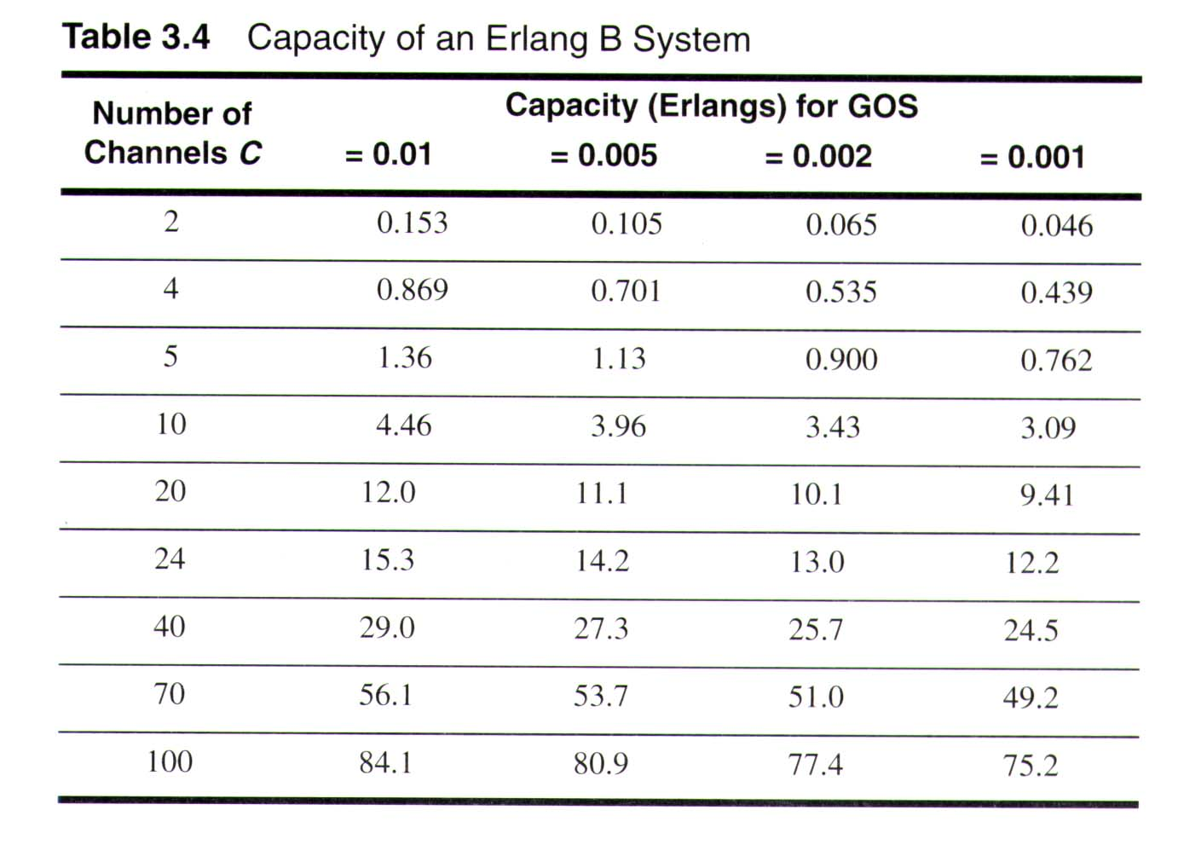

Slide 6
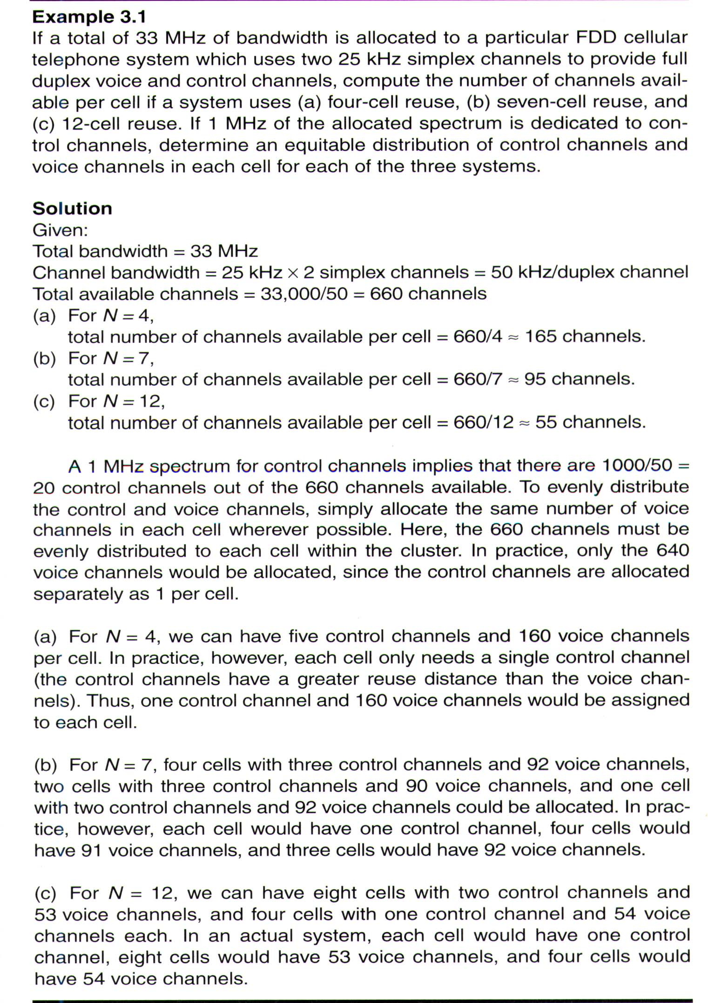

Slide 7
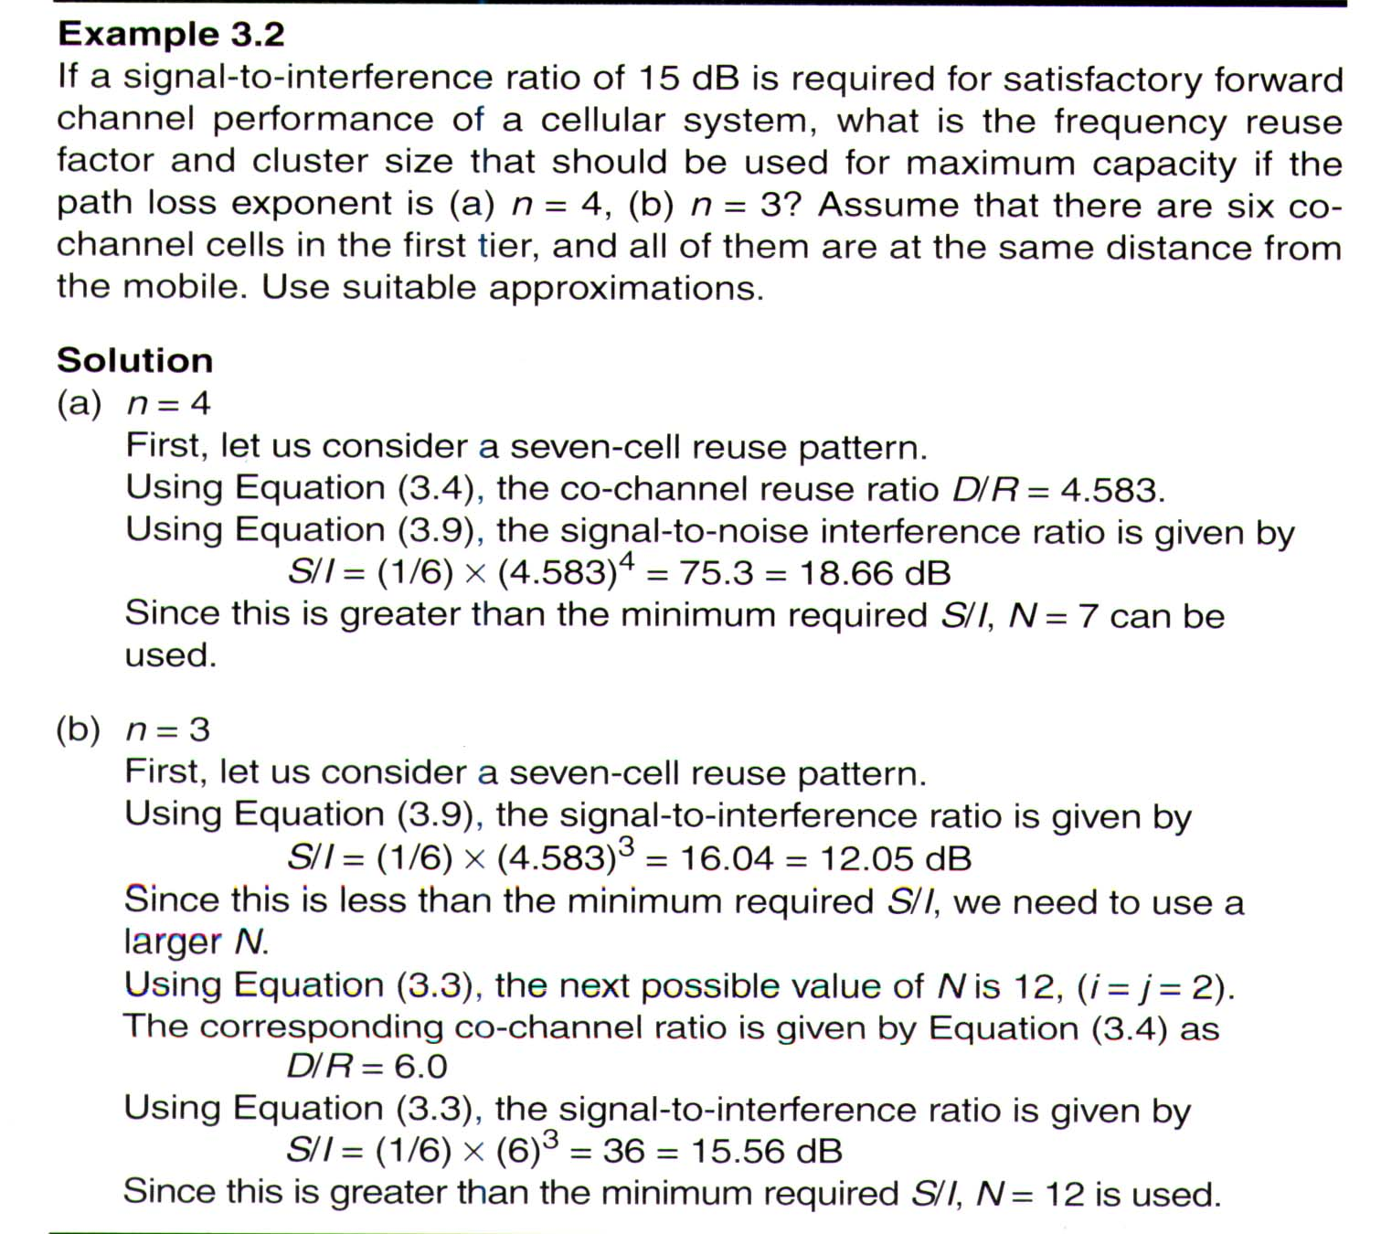

Slide 8
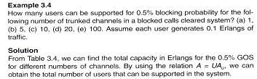
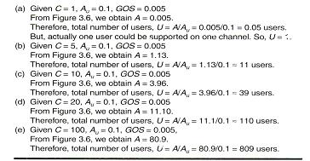

Slide 9
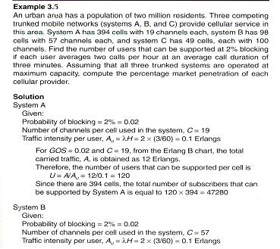
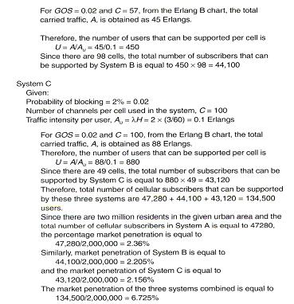

Slide 10
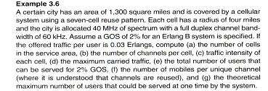
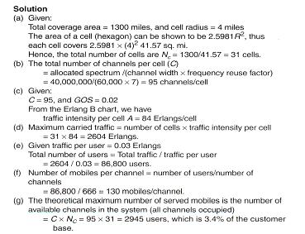
Notes:
3.Root of 3/2

Slide 11
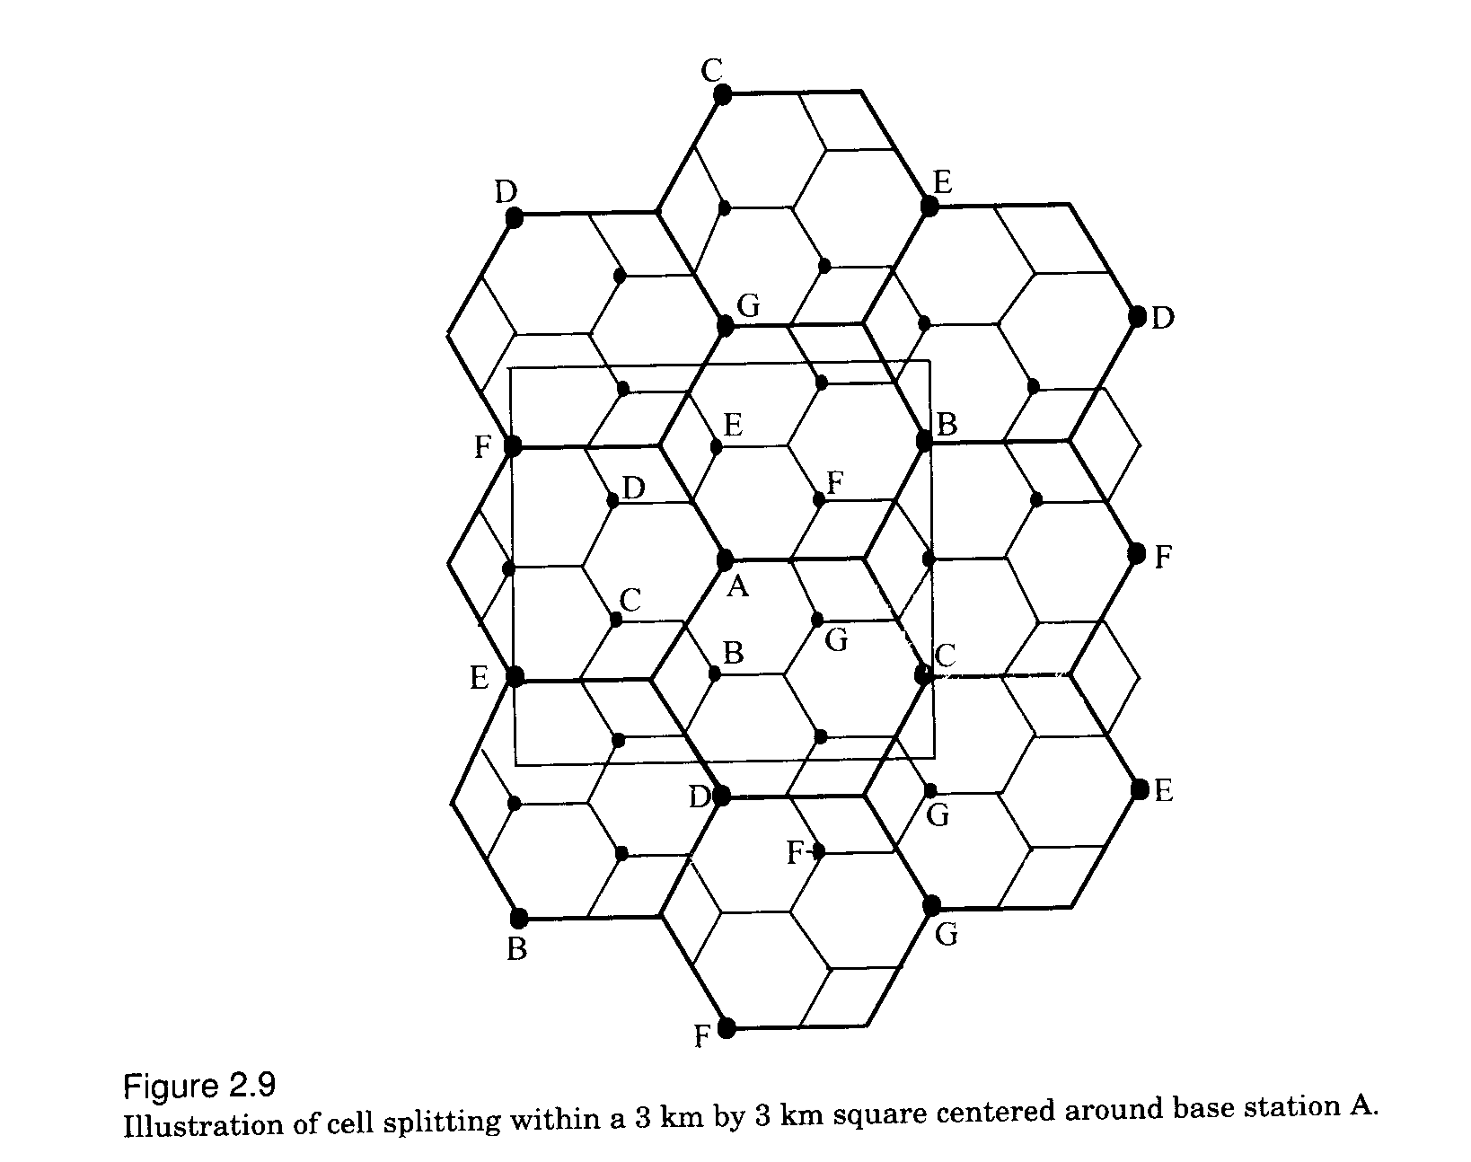
Fig 3.9

Slide 12
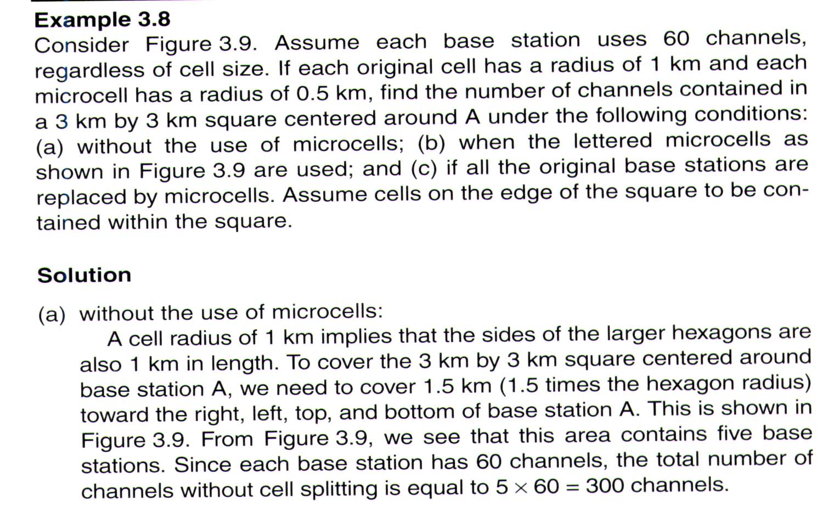
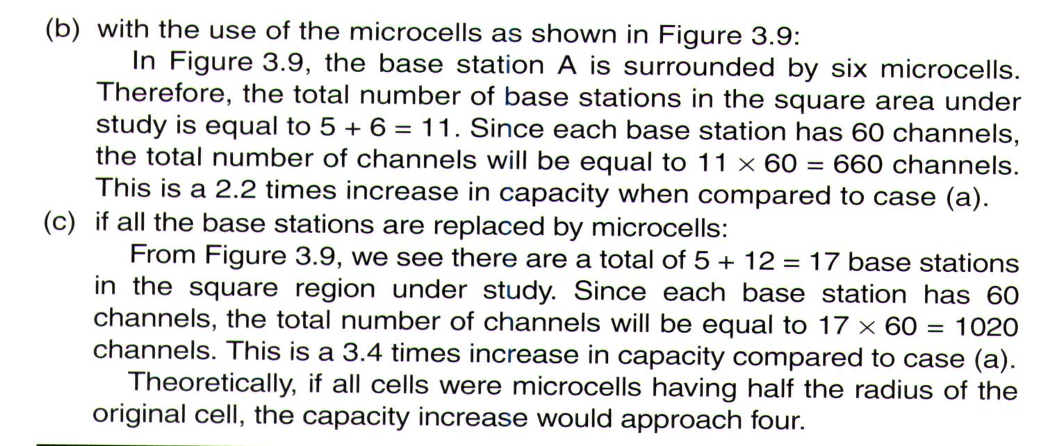

Slide 13
Thank You

